Slide 1

Alabama Veterans Museum
Presented by Phillip Owens and Nicholas Morgan
Final Presentation

Slide 2
The Project
The Alabama Veterans Museum project consisted of a GUI front-end to an SQL database for deceased veterans created by a previous team from Athens State University.
The Museum Administration requested several additional items be added to the application.
The Athens Veterans Museum has records on over 3300 names of deceased veterans of Limestone Country with about 1000 more still to track.

Slide 3
Requested Changes
A solution for automatically backing up the application’s SQL data was required.
Notification that data had been successfully saved was requested.
The ability to clear previous data from forms when starting a new record was also requested.
Problems with displaying the User Guide from the original project needed to be addressed

Slide 4
Requested Changes
Google Maps directions to grave site
Repurposing the Marker Photo for Veterans
Change Requirements for DOB/DOD
Uploading correct image formats
Find A Grave button directing to the website

Slide 5
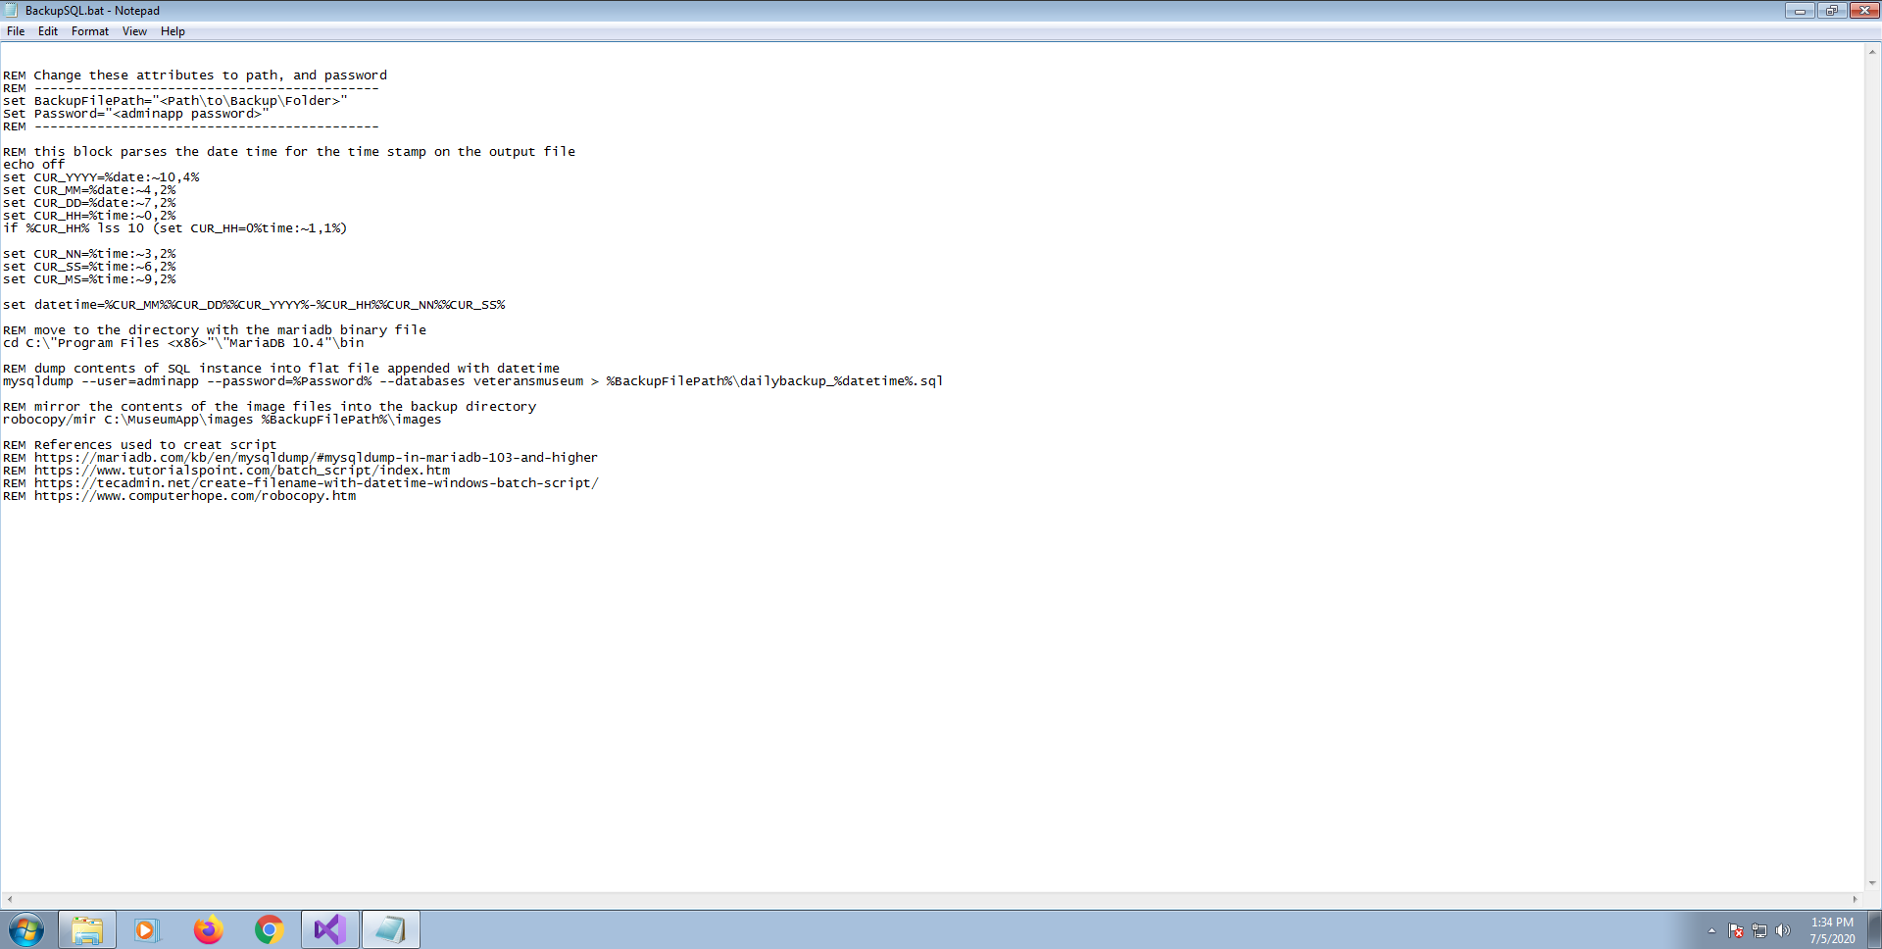
SQL Backup Solution

Slide 6
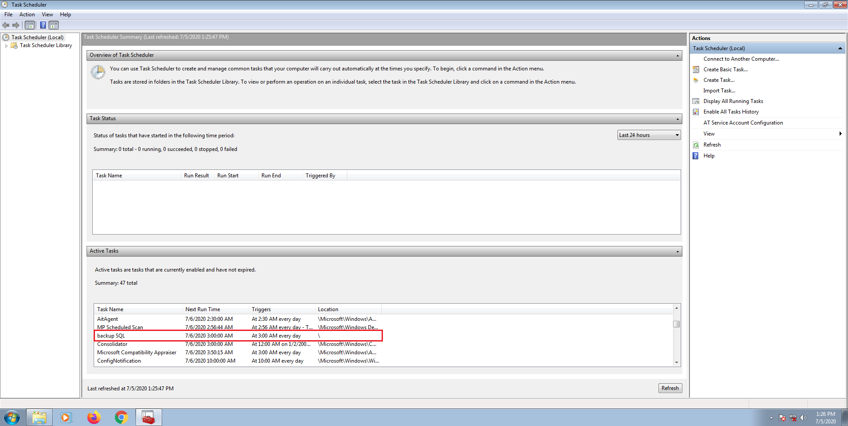
SQL Backup Solution

Slide 7
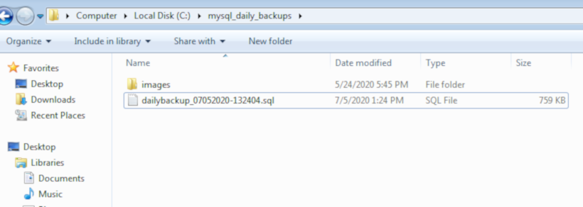
SQL Backup Solution

Slide 8
Application User Guide
The User Guide exists as a .pdf file.
It is installed to the disk by the installed batch file.
A browser shortcut is created on the desktop by the installer.
The shortcut opens the .pdf file using the systems internet browser.

Slide 9
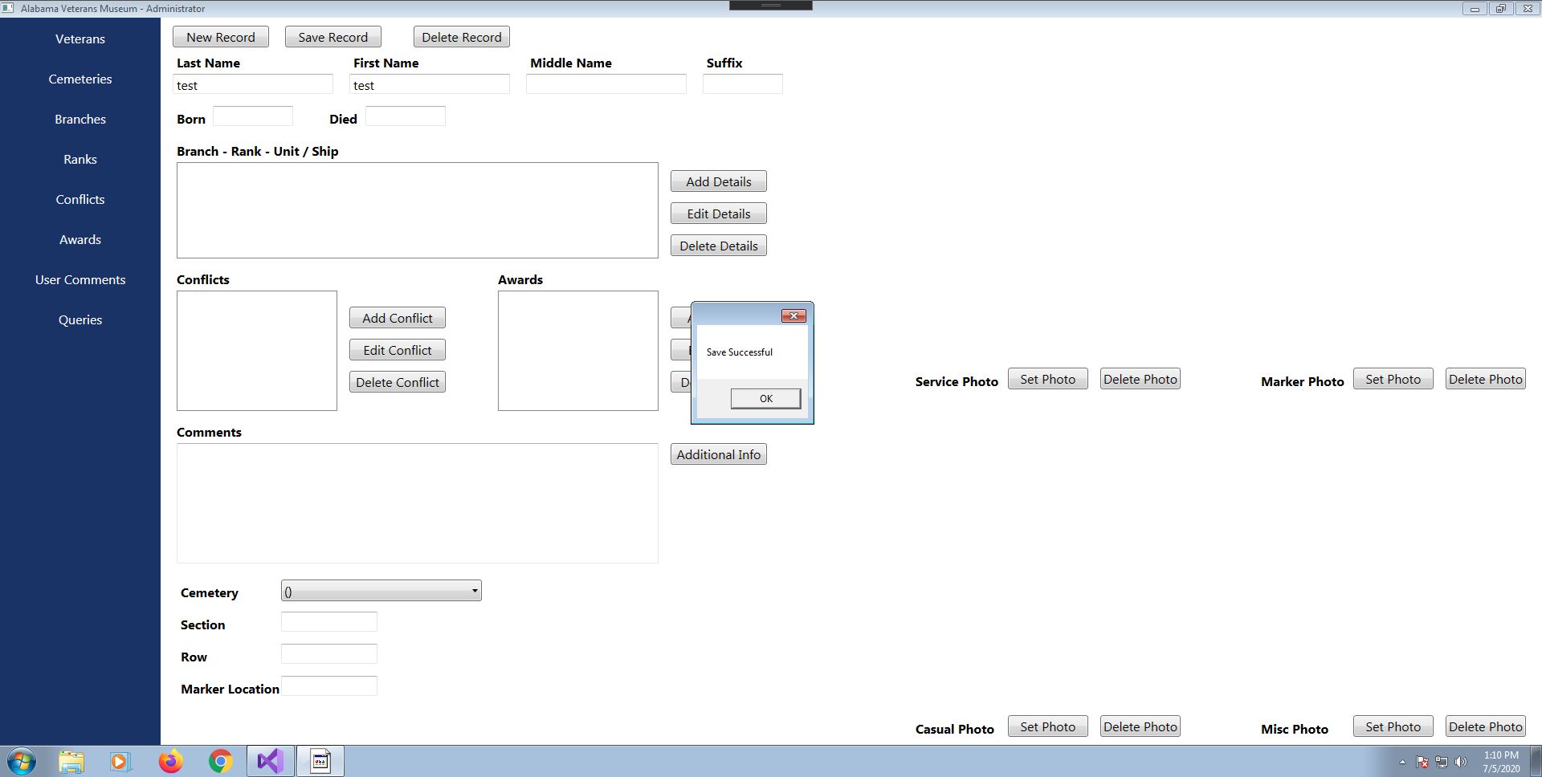
Save Notification

Slide 10
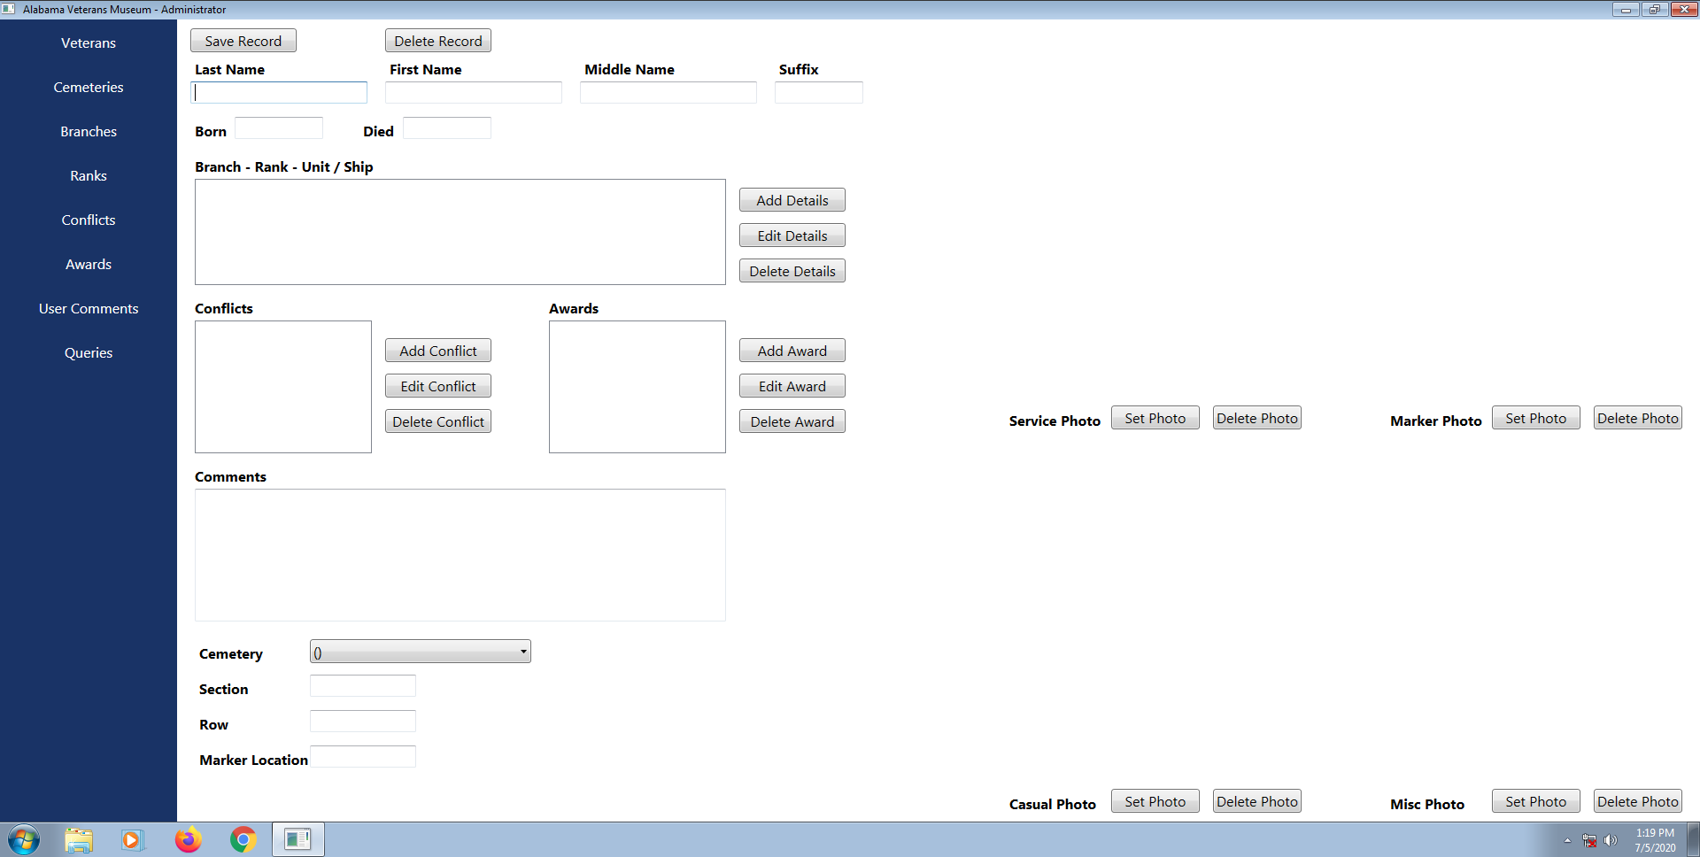
Clearing Forms
Existing GUI

Slide 11
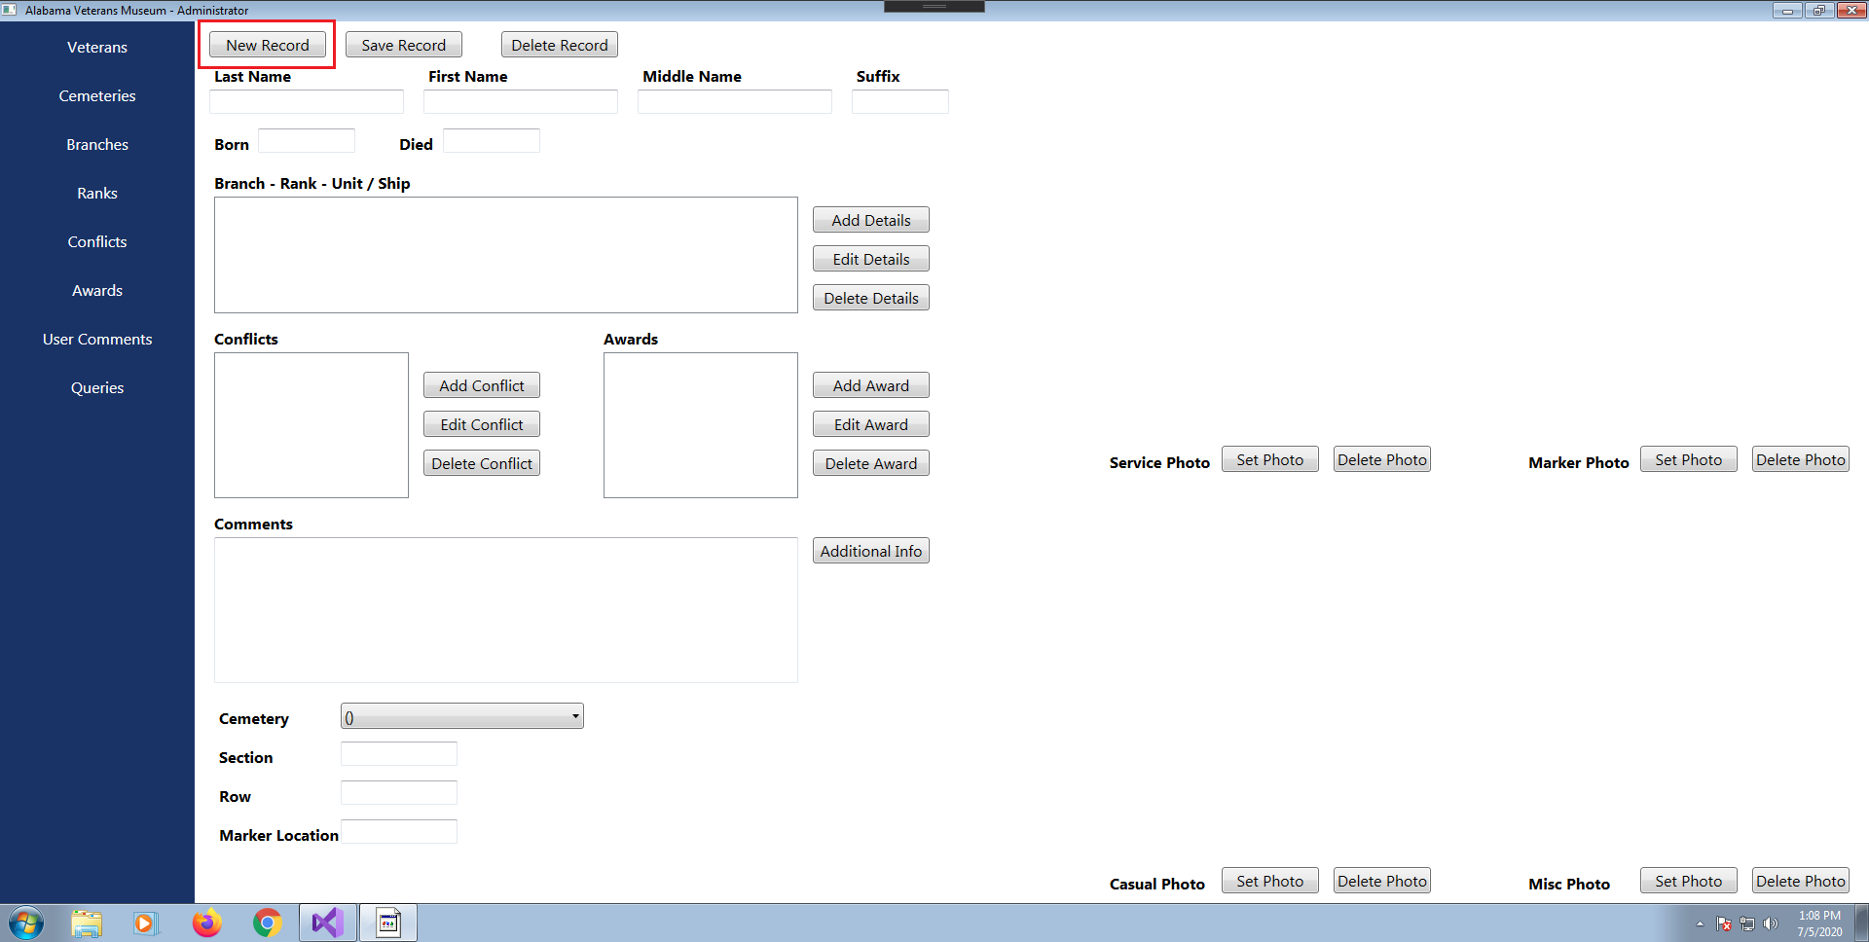
Clearing Forms
New GUI

Slide 12
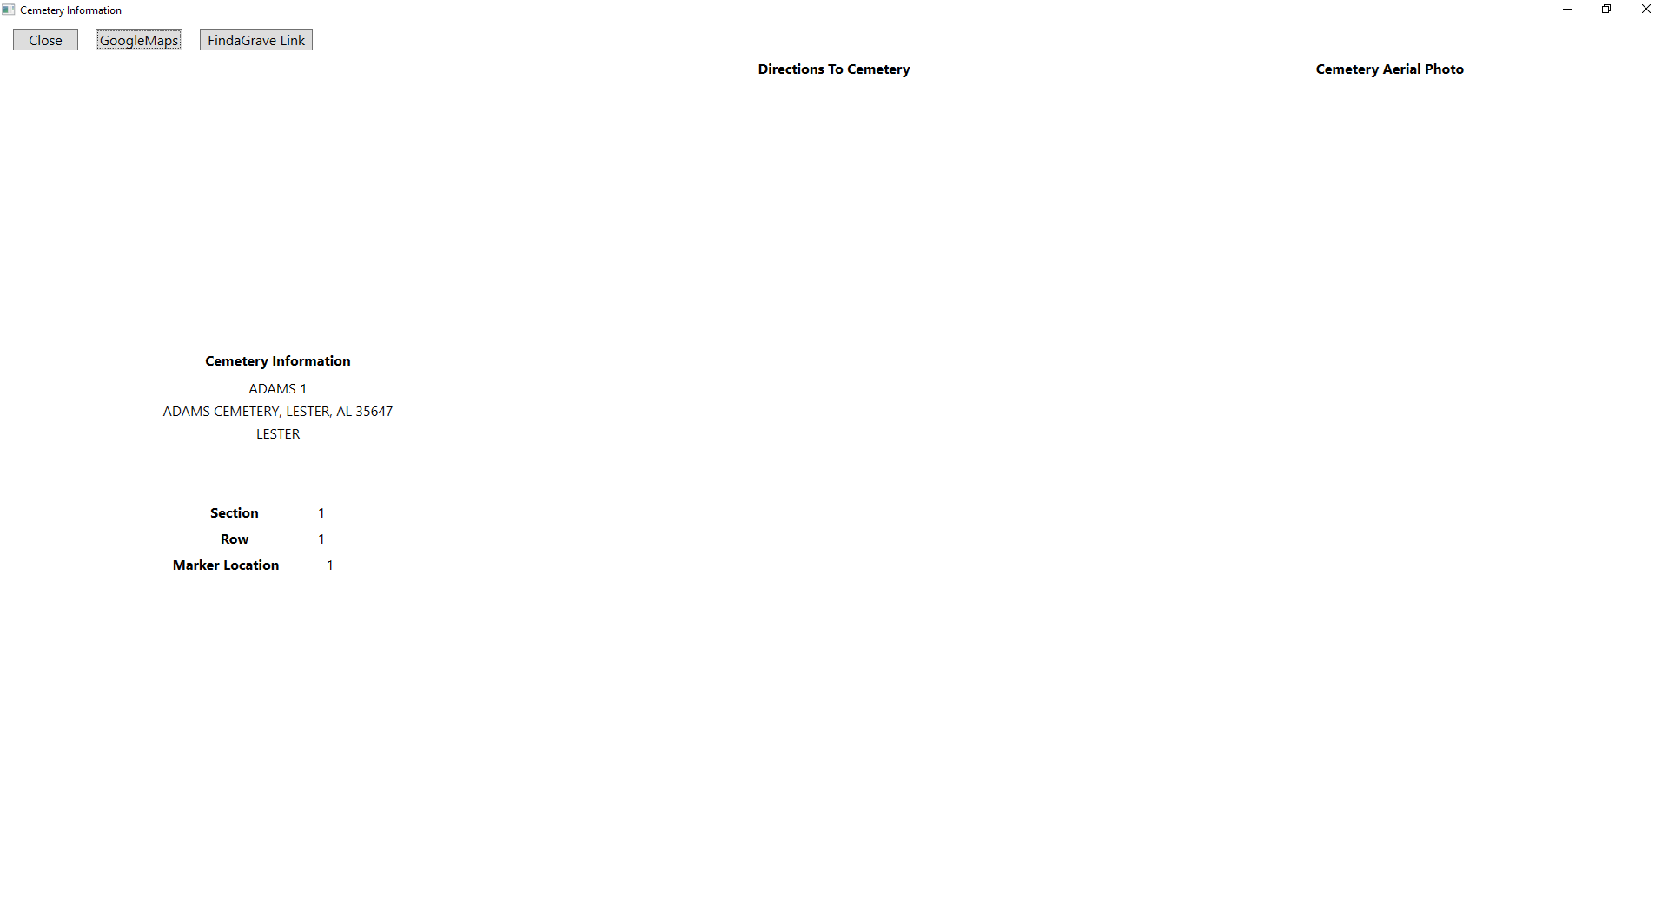
Google Maps

Slide 13
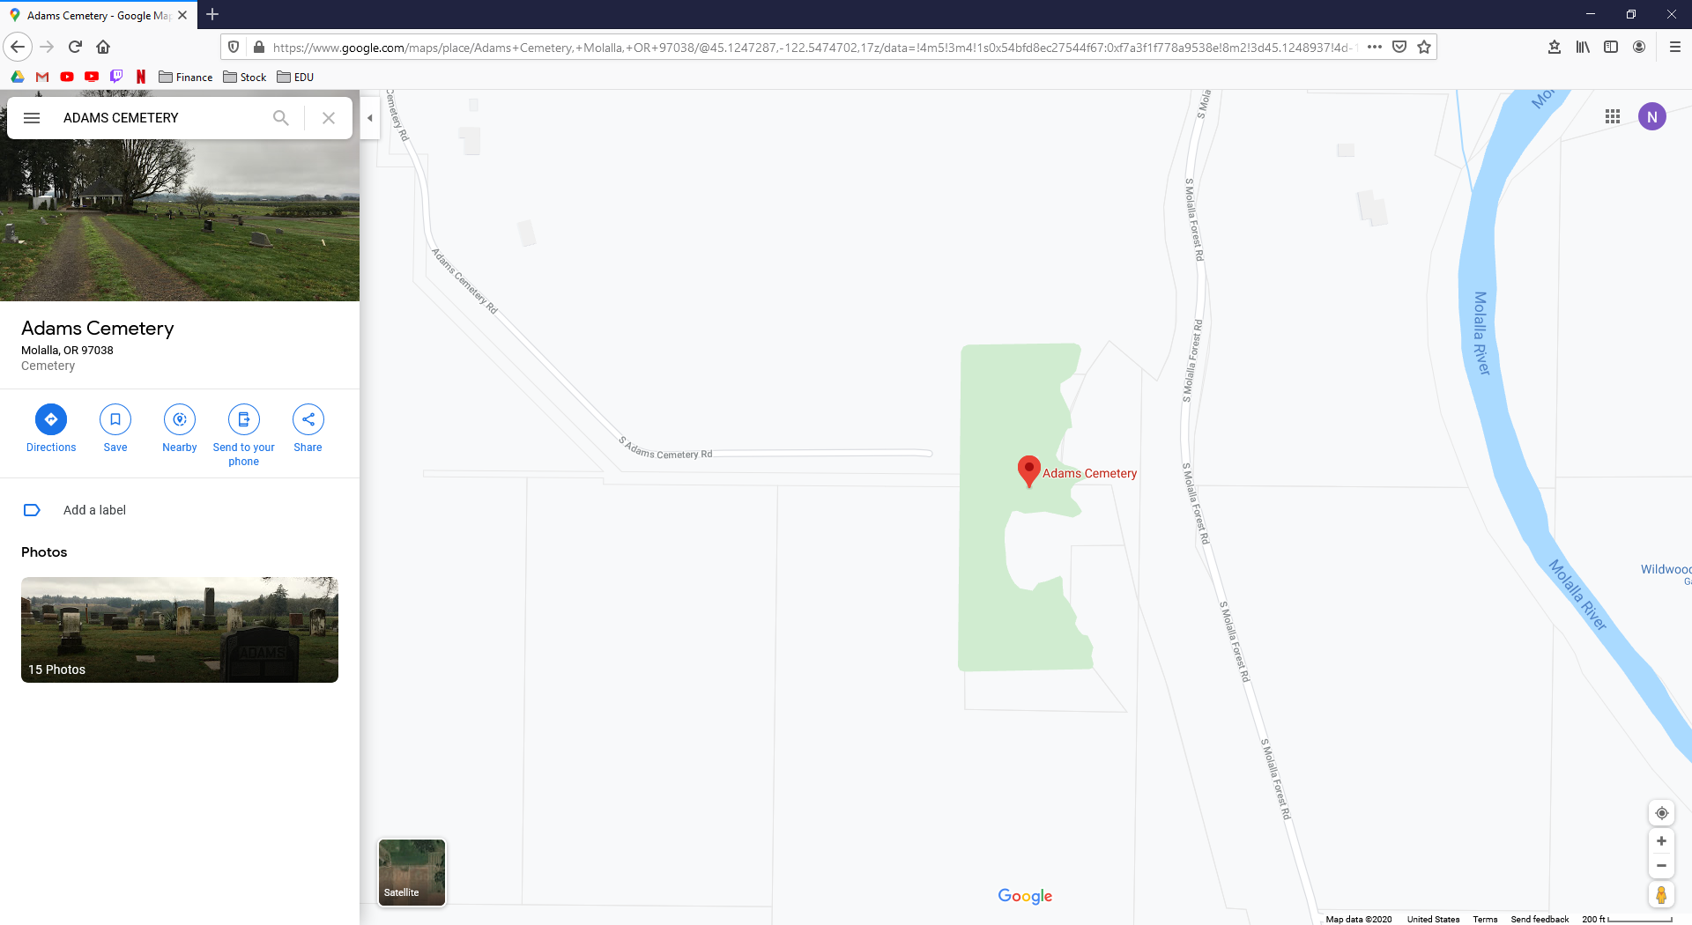
Google Maps

Slide 14
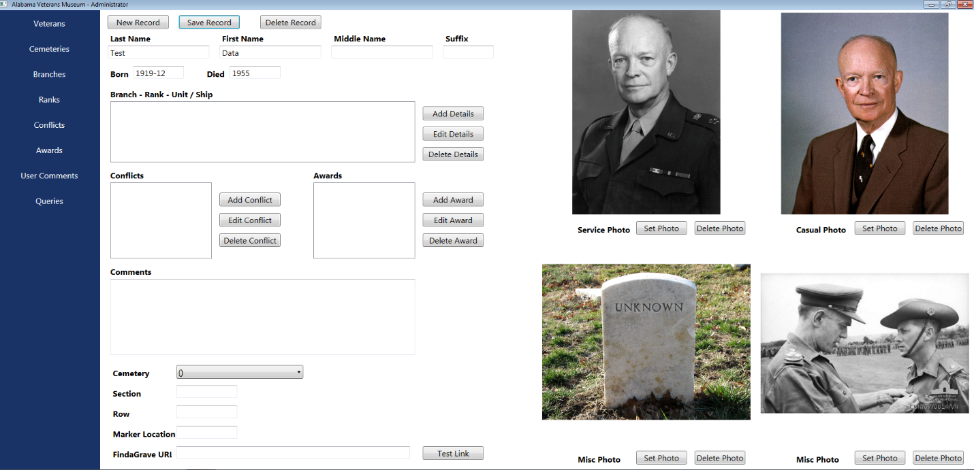
DOB/DOD Changes

Slide 15
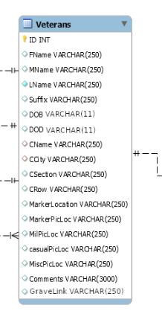
ER Diagram

Slide 16

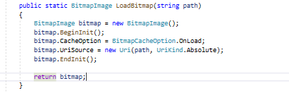
Upload Image Crash

Slide 17
Find A Grave
Admin

Slide 18
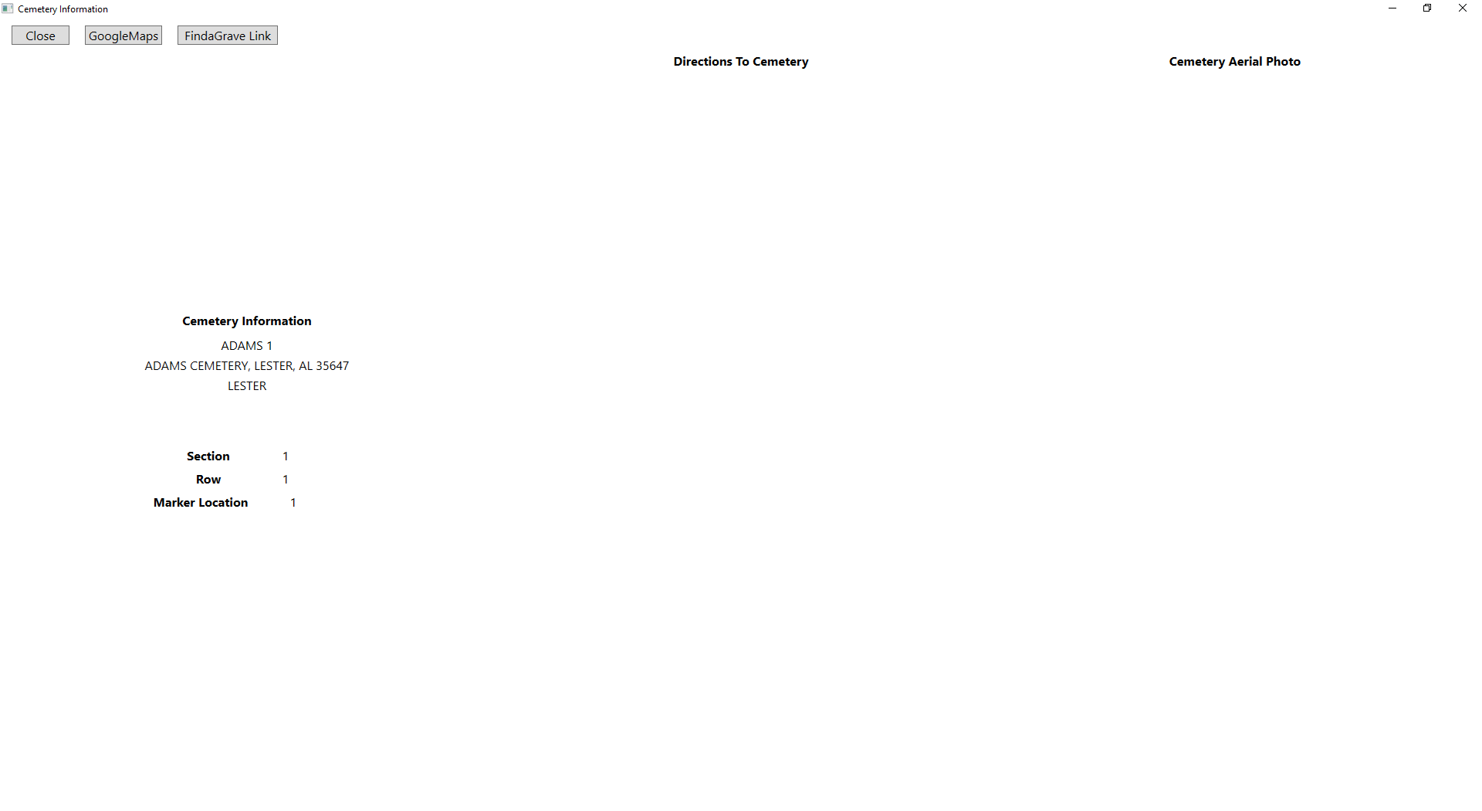
Find A Grave
Viewer

Slide 19
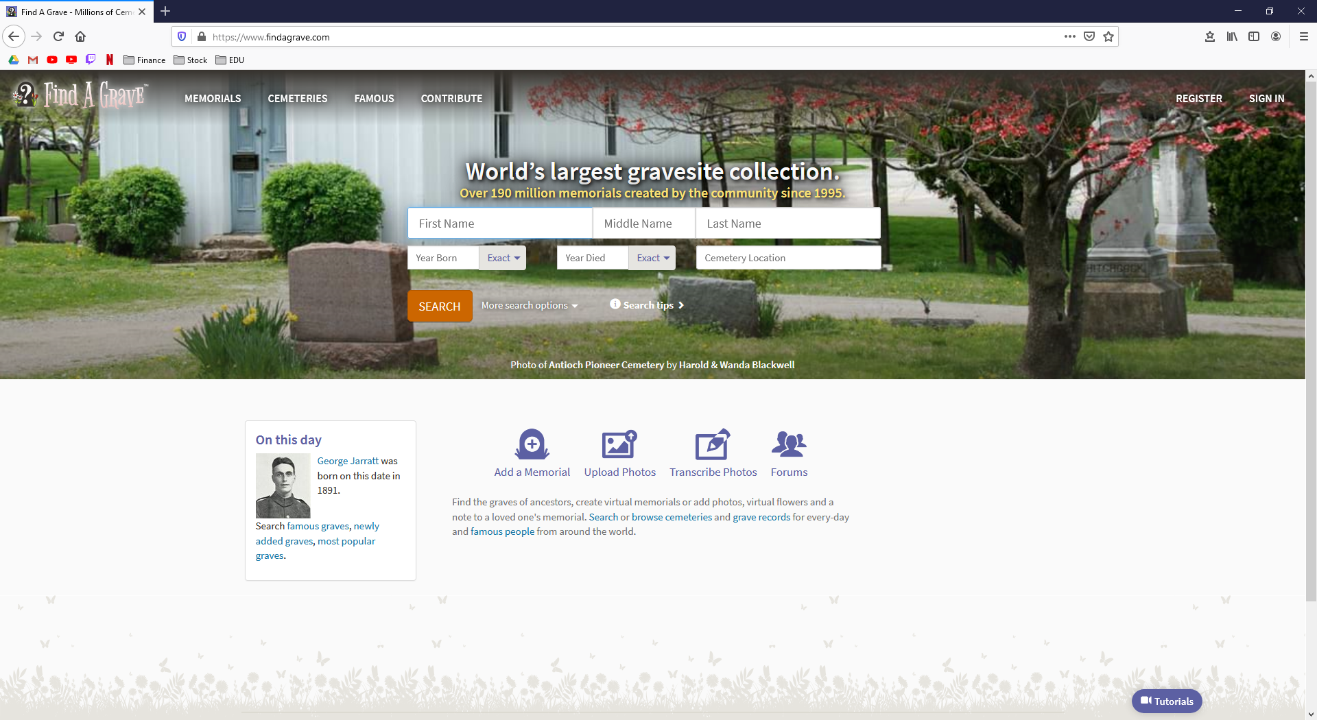
Find A Grave
Website

Slide 20
Misc Picture

Slide 21
Thank You

